Slide 1
Synchronization Examples
Chapter 7
Bounded Buffer Problem
Readers-writers Problem
Dining Philosophers Problem

Slide 2

Classic Problems of Synchronization
Examples of a large class of concurrency-control problems
Problems used for testing any newly proposed synchronization scheme
The Bounded-Buffer Problem
Commonly used problem to illustrate the power of synchronization primitives
A general structure of the scheme
Both processes share common data structures
Assume that the pool consists of n buffers
The mutex semaphore provides mutually exclusive access to the buffer pool
The codes for producer and consumer processes
Symmetry exists between the two

Slide 3
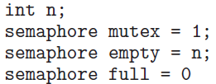
Bounded Buffer Problem – Producer Process
while (true) {
...
/* produce an item in next_produced */
...
wait(empty);
wait(mutex);
... /* add next produced to the buffer */
...
signal(mutex);
signal(full);
}
Notes:
3

Slide 4
Bounded Buffer Problem – Consumer process
while (true) {
wait(full);
wait(mutex);
... /* remove an item from buffer to next_consumed */
...
signal(mutex);
signal(empty);
... /* consume the item in next consumed */
... }
Notes:
4

Slide 5
Classic Problems of Synchronization
The Readers-Writers Problem
Shared data are read and written by various processes
Processes which only read are called readers
Processes which perform both read and write operations are referred to as writers
A writer and another process should not access the data simultaneously
Readers-writers problem
Several variations exist, involving priorities
First readers-writers problem
No reader will be kept waiting unless a writer has already obtained permission to use the shared object

Slide 6
Classic Problems of Synchronization
Second readers-writers problem
Once a writer is ready, it performs its write as soon as possible
If a writer is waiting, no new readers may start reading
Solution to either problem results in starvation
Writers may starve in the first case and readers may starve in the second case
Solution to the first readers-writers problem
Reader processes share some data structures initialized to the indicated values
Code for a writer and a reader process
This problem has been generalized to provide reader-writer locks on some systems

Slide 7
Solution to First Readers-Writers Problem
rw_mutex = 1
while (true) { wait(rw_mutex);
...
/* writing is performed */
...
signal(rw_mutex);
}
Writer process
Notes:
7

Slide 8

Solution to First Readers-Writers Problem
while (true){ wait(mutex); read_count++; if (read_count == 1)
wait(rw_mutex);
signal(mutex);
...
/* reading is performed */
... wait(mutex); read_count--; if (read_count == 0)
signal(rw_mutex);
signal(mutex);
}
Reader process
Notes:
8

Slide 9
Classic Problems of Synchronization
Acquiring the lock must specify the mode of the lock
Either read or write access
Multiple processes may access the lock in read mode
Only one process may acquire the lock for writing
Reader-writer locks are useful in the following situations
In applications where it is easy to identify readers and writers
In applications that have more readers than writers

Slide 10
Classic Problems of Synchronization
The Dining-Philosophers Problem
A group of five philosophers share a round table with five chairs, five plates and five chopsticks
A philosopher eats when both chopsticks are available
This represents a large class of concurrency-control problems
Need to allocate resources among processes in a deadlock-free and starvation-free manner
Represent each chopstick with a semaphore
semaphore chopstick[5];
No two neighbors are eating simultaneously
The solution could create a deadlock

Slide 11
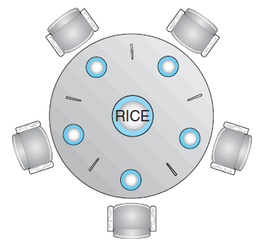
Dining-Philosophers Problem
Notes:
11

Slide 12
Dining-Philosophers Problem
Structure of Philosopher i
while (true){
wait (chopstick[i] );
wait (chopStick[ (i + 1) % 5] );
. . .
/* eat for awhile */
. . .
signal (chopstick[i] );
signal (chopstick[ (i + 1) % 5] );
. . .
/* think for awhile */
. . .
}
Notes:
12

Slide 13
Classic Problems of Synchronization
Suppose all philosophers pick their right chopstick simultaneously
All would be delayed for ever for their left chopstick
Deadlock occurs
Several possible solutions can be implemented
Allow at most four philosophers to be sitting at the table simultaneously
Allow philosophers to pick up the chopsticks if both are available
Pick up chopsticks in a critical section

Slide 14
Classic Problems of Synchronization
Use an asymmetric solution
An odd numbered philosopher picks up the left chopstick first and then the right chopstick
An even numbered philosopher picks up the right chopstick first and then the left chopstick
Possibility of starvation of at least one philosopher exists
A deadlock-free solution may not be starvation-free
Synchronization used by Operating System
Read about the implementation in any one of the operating systems

Slide 15

Deadlocks Chapter 8
Description of Deadlocks
Methods of Preventing or
Avoiding Deadlocks
Detection and Recovery from Deadlocks

Slide 16
Overview
Why do deadlocks occur?
Four necessary conditions for deadlocks
Methods of dealing with deadlocks
Ignore the problem
Prevent or avoid deadlocks
Detect and recover from deadlocks
Deadlock prevention and avoidance algorithms
Safe sequence
Detection algorithms
Recovery methods
Selection of victim process
Rollback and starvation

Slide 17
Introduction
Several processes/threads compete for a finite number of resources in a multiprogramming environment
When a thread requests resources and it is not available
It goes into a wait state
This can be an indefinite wait
Deadlock has occurred
Methods used by OS and application programmers to deal with deadlocks
Deadlock problems are becoming more challenging as demand is growing for more concurrency and parallelism on multicore systems

Slide 18
System Model
A system consists of a finite number of resources that are distributed among the competing threads
The resources are of different types and may consist of a number of instances of the same type
Memory space Files
CPU cycles I/O devices
If a thread requests a resource of a type
Any instances of that type can satisfy the request
A thread must request a resource before using it and must release the resource after using it
The total number of resources requested may not exceed the total number of available resources

Slide 19
System Model
Resource utilization is done in the following sequence of steps
Request: If the request cannot be granted immediately
The thread must wait until it acquires the resource
Use: The thread can operate on the resource
Release: The thread releases the resource
Request and release of resources are done through system calls
Request and release of semaphores can be accomplished through wait() and signal() operations on semaphores
OS maintains a table of the current allocations of all the resources

Slide 20
System Model
A set of threads are in a state of deadlock when every thread in the set is waiting for an event that can be caused only by another thread in the set
Events are acquisition and release of resources
Resources can be both physical and logical
Other types of events may also cause deadlock
Deadlock may involve same resource type or different resource types
Multithreaded programs have a greater chance of a deadlock
Use of mutex operation on locks in a particular sequence may result in deadlock

Slide 21
Deadlock Characterization
Examine the features that characterize deadlocks
Threads never complete execution and resources are occupied
Necessary Conditions
A deadlock may occur if the following four conditions hold simultaneously in a system
Mutual exclusion
At least one resource must be held in a non-sharable mode
Hold and wait
A thread must be holding at least one resource and is waiting for another resource that is currently being held by another thread

Slide 22
Deadlock Characterization
No preemption
Resources cannot be preempted
Circular wait
A set {T0, T1, …, Tn} of waiting threads must exist such that
T0 is waiting for a resource held by T1
T1 is waiting for a resource held by T2,….., and
Tn is waiting for a resource held by T0
All four conditions must hold at the same time
Circular wait condition implies the hold-and-wait condition
The four conditions are not completely independent

Slide 23
Resource Allocation Graph
Deadlocks can be described in terms of a directed graph
System resource-allocation graph
Set of vertices V is partitioned into two different types of nodes
T = {T1, T2, …,Tn} The set consisting of all the active threads in the system - circle
R = {R1, R2,…, Rn} The set of all resource types in the system – rectangle with dots
Set of edges E
Request Edge: A directed edge from a thread Ti to a resource Rj
It signifies that thread Ti has requested an instance of the resource Rj and is currently waiting for the resource
Denoted by Ti → Rj

Slide 24
Resource-Allocation Graph
Assignment edge: A directed edge from a resource type Rj to a thread Ti
It signifies that an instance of resource Rj has been allocated to thread Ti
Denoted by Rj → Ti
Request edge is converted to an assignment edge if a resource becomes available and is allocated
Assignment edge is deleted when a thread releases a resource
Example resource allocation graph
If the graph contains no cycles, no thread in the system is deadlocked
Deadlock may exist, if the graph contains cycles

Slide 25
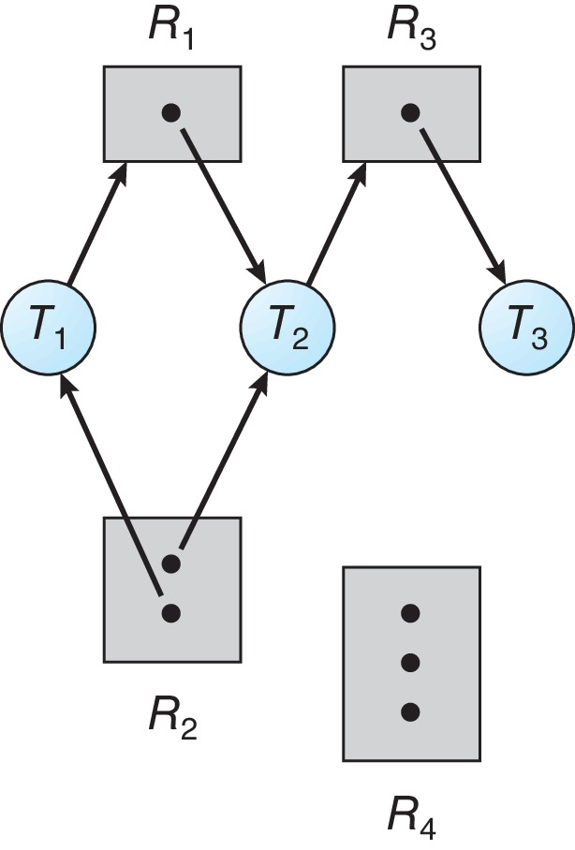
Example of a Resource Allocation Graph
Sets T, R and E
Resource instances
Thread states
Notes:
25

Slide 26
Example of a Resource Allocation Graph
Sets T, R and E
Set of threads = {T1, T2, T3}
Set of Res. = {R1, R2, R3, R4}
Set of Edges={T1→ R1,
T2→R3, ……
Resource instances
Thread states
Notes:
26

Slide 27
Resource Allocation Graph
If each resource type has exactly one instance, a cycle with such resources implies that a deadlock has occurred
A cycle is both a necessary and a sufficient condition with single instance of each resource
If each resource type has several instances, a cycle does not necessarily imply that a deadlock has occurred
Example resource allocation graphs
If a resource-allocation graph does not have a cycle then the system is not in a deadlocked state

Slide 28
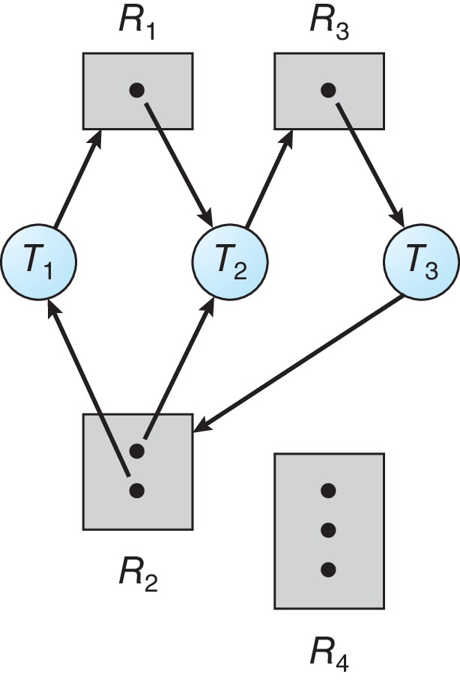
Resource Allocation Graph With A Deadlock
T3 requests an instance of resource R2
Notes:
28

Slide 29
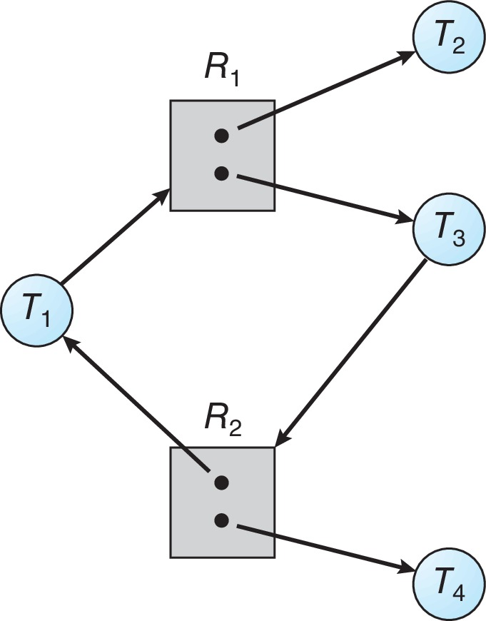
Graph With A Cycle But No Deadlock
Notes:
29

Slide 30
Methods for Handling Deadlocks
Deadlock problem can be handled in one of three ways
Ignore the problem assuming that deadlocks never occur in the system
Use protocol to prevent or avoid deadlocks
The system never enters a deadlocked state
Allow the system to enter a deadlocked state, detect it and recover
None of the basic approaches alone can solve all resource allocation problems
Requires an optimal approach for each class of resources in a system
Deadlock prevention provides a set of methods to ensure that at least one of the necessary conditions cannot hold

Slide 31
Methods for Handling Deadlocks
Deadlock avoidance requires threads to give advance information about their resource needs
Every request is evaluated by OS before allocation to avoid deadlock in future
When the system uses neither prevention nor avoidance algorithms, it may enter into deadlock condition
A deadlock detection algorithm is needed to detect deadlocks if any
In addition, a recovery algorithm is required to recover from deadlock
When none of the above is used in a system, it may enter deadlock and cause a system to stop functioning – manual restart is required
This is the most commonly used method in OS

Slide 32
Deadlock Prevention
Ensure that at least one of the necessary conditions does not hold
Mutual Exclusion
Mutual exclusion is desired for all resources that are not sharable
Deadlock cannot be prevented by denying the mutual-exclusion condition
Some resources are intrinsically nonsharable
Hold and Wait
To deny this condition, following is the requirement
Whenever a thread requests a resource, it must be guaranteed that it does not hold any other resources

Slide 33
Deadlock Prevention
One solution is that each thread acquires all its resources before it begins execution
Place all the system calls for resources in the beginning of the program
This is not a practical solution
Alternative is to allow a thread to request a resource only if it has none
A thread must release all the resources that it is currently allocated
Thread can be restarted only when all the required resources become available
Disadvantages of the above protocols
Resource utilization may be low
Starvation is possible

Slide 34
Deadlock Prevention
No Preemption
To deny this condition, one of the following may be used
If a thread is holding some resources and it requests more resources that cannot be immediately granted
All resources that the thread is currently holding is preempted
Thread is restarted only when all the resources become available
An alternative: If the resource is not available
Check if any of the waiting threads are holding the resource
If this is not true, the requesting thread waits
Its resources can be taken away if requested by another thread

Slide 35
Deadlock Prevention
This can be applied to resources that can be saved and restored later
Circular Wait
Impose a total ordering of all resource types
Each thread requests resources in an increasing order of enumeration
Let {R1, R2, …,Rm} be the set of resource types
Assign each resource type a unique integer
Define a one-to-one function F: R→ N, where N is the set of natural numbers
Protocol to prevent deadlocks
Each thread can request resources only in an increasing order of enumeration

Slide 36
Deadlock Prevention
A thread can request instance of resource Rj iff F(Rj) > F(Ri)
An alternative: Whenever a thread requires an instance of resource Rj, it has released any resource Ri such that, F(Ri) ≥ F(Rj)
Accomplish this in an application program
Develop an ordering among all synchronization objects in the system
All requests to synchronization objects must be made in increasing order
Application developers must follow the ordering
Function F should be defined according to the normal order of usage of the resources in a system

